Slide 1







SURVEY ANALYSIS
KAYODE OLUBUNMI ABIMBOLA
11TH JUNE, 2024

Slide 2



OUTLINE
Executive Summary
Introduction
Methodology
Results
Visualization – Charts
Dashboard
Discussion
Findings & Implications
Conclusion
Appendix

Slide 3

EXECUTIVE SUMMARY
This is an analysis of a survey carried out among Technical staffs of a company.
Descriptive analysis
Most of the respondents are men and have masters degree.
Majority are within the age groups of 40 – 60 years and a higher number of respondents are from Afghanistan.
Most of the respondents currently uses java as a programming language and query database with MySQL.
The commonest webframe used is iQuery and the platform commonly used include Windows, Linus and AWS.

Slide 4

INTRODUCTION
The advent of Artificial Intelligence has necessitated employees to ensure continuous upgrade in their skills in order to remain relevant in the field.
Although some languages and technical softwares have been in existence for quite an age and still remain relevant, new tools are being developed to enhance efficiency.
It is therefore essential to create awareness and make a research on the adoption of these new tools.

Slide 5

METHODOLOGY
Data was provided by IBM for capstone project and downloaded as csv file.
Data exploration and wrangling was done with python.
Visuals and dashboard was created with IBM cognos analytics.
Result was downloaded as pdf and uploaded to Github.

Slide 6
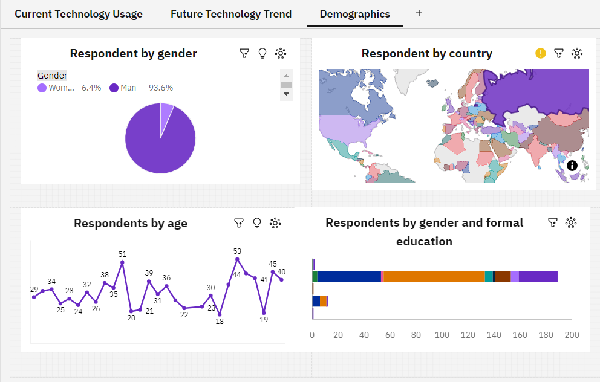
RESULTS
Dashboard showing the demographics of participants

Slide 7
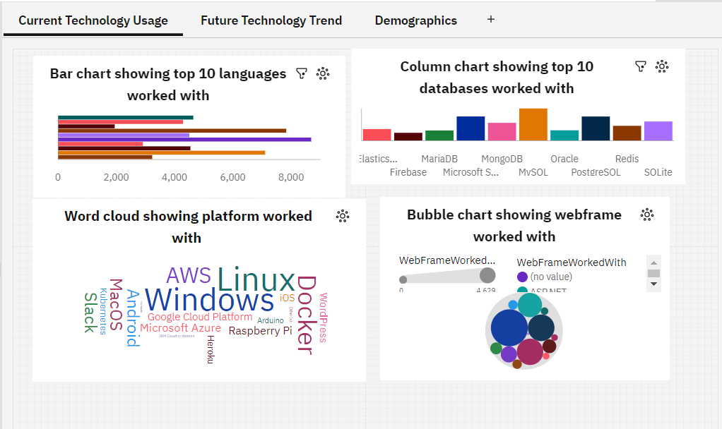
RESULTS
Dashboard showing the technologies being used at present

Slide 8
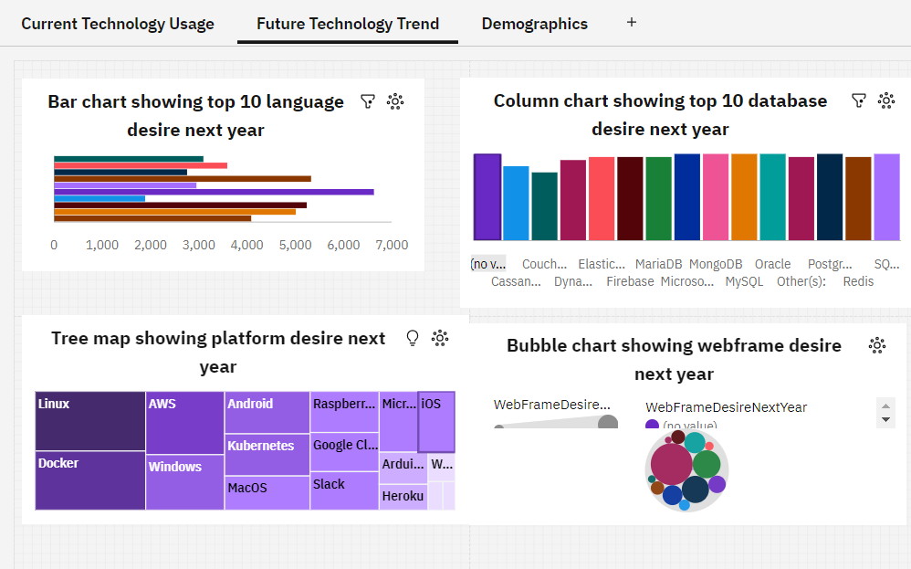
RESULTS
Dashboard showing technologies respondents intend to use in the future

Slide 9
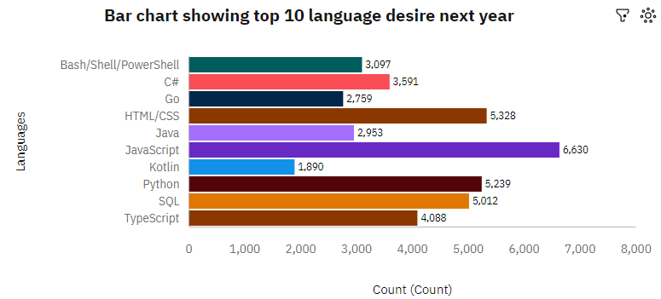
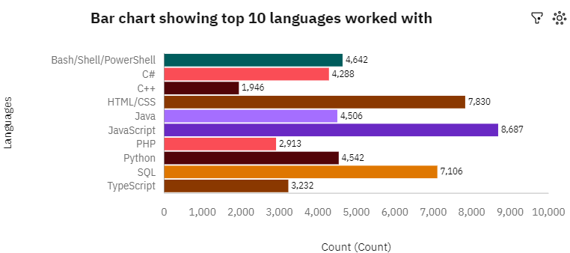
PROGRAMMING LANGUAGE TRENDS
Current Year
Next Year

Slide 10
PROGRAMMING LANGUAGE TRENDS - FINDINGS & IMPLICATIONS
Findings
Javascript ,html/CSS still remain the top language of choice by respondents.
More respondents are looking forward to learning python in the coming year.
Majority of the respondents appear not to be interested in C++
Implications
More web and software developers will emerge.
More companies will likely include python in their job requirement for the coming year.
C++ will most likely become obsolete.

Slide 11
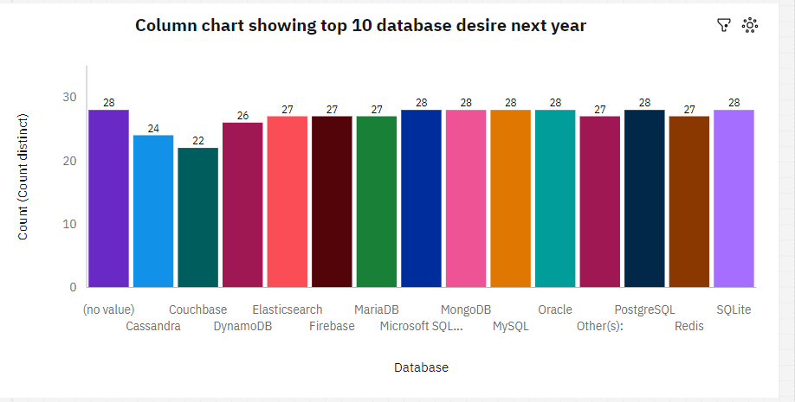
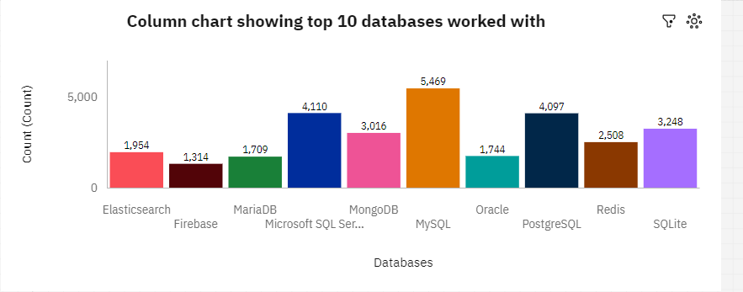
DATABASE TRENDS
Current Year
Next Year

Slide 12
DATABASE TRENDS - FINDINGS & IMPLICATIONS
Findings
Majority of the respondents make use of MySQL, Postgresql and Microsoft SQL server at present.
There is no significant difference in their choice of database for the coming year
Implications
MySQL, Postgresql and Microsoft SQL server are likely to be overloaded.
More job opportunities for expert in any database will be created

Slide 13

DASHBOARD
https://github.com/kayodeolubunmi/dashboard/blob/main/Capstone%20project%20dashboard.pdf

Slide 14
DASHBOARD TAB 1

Slide 15
DASHBOARD TAB 2

Slide 16
DASHBOARD TAB 3

Slide 17
DISCUSSION
Majority of those in the technical sector are men and have postgraduate degrees.
Majority of the respondents are within the age groups of 40 – 60 years and a higher number of respondents are from Afghanistan.
Although most of the respondents uses java as programming language, more people intend to learn python.

Slide 18
OVERALL FINDINGS & IMPLICATIONS
Findings
Majority of the respondents are men.
Most of the respondents are those with graduate degrees
Java still remain the programming language of choice currently being used and intended to be used in the coming year.
Implications
New job postings may have higher demand for java.
Undergraduate might not be opened to job opportunities

Slide 19

CONCLUSION
Most of the common databases are intended to be learnt by the respondents.
In addition, Java still remains significant while C++ is becoming obsolete.

Slide 20

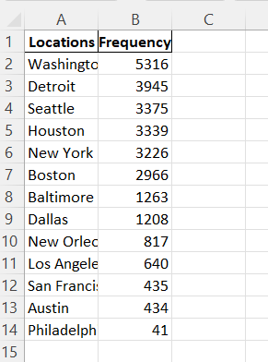
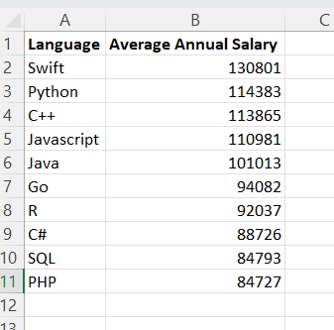
APPENDIX
Job postings data
Popular languages data

Slide 21
JOB POSTINGS

Slide 22
POPULAR LANGUAGES

